Slide 1
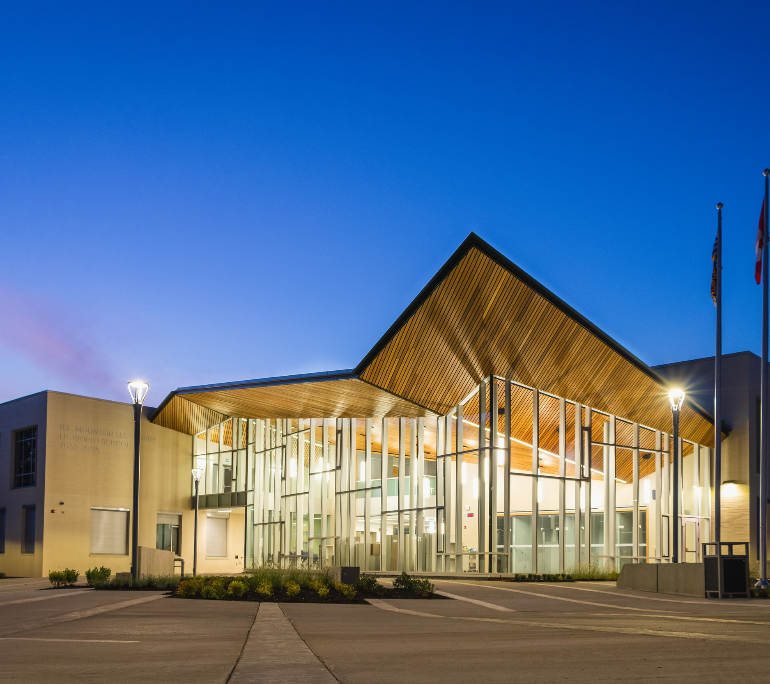
HVAC
BMS
Building Services
Electrical Engineering
GREEN AND FUTURE-FIT FACILITIES
Building Services of VTU

Slide 2

GREEN AND FUTURE-FIT FACILITIES
Customers who are building a production facility must do a tremendous number of decisions. It is always a challenging journey from the initial idea to the market-ready product . During this journey, VTU’s building services provides a competent support on HVAC, BMS, and electrical engineering, in order to enable a smooth project execution: in-time, in budget. VTU is engineering, procuring and managing your plant and facility construction (EPCMv). Furthermore, VTU coordinates the process engineering, plant qualification and all other interfaces needed for a trouble-free operation of your plant. VTUs building services are designed to be highly energy efficient, with lowest possible emissions, and packed with the most modern digitalization solutions: Customers gets more than a green and future-fit production plant.
SERVICE PORTFOLIO
PROJECT EXECUTION AND TOOLS
Overall building service concepts - energy optimized and sustainable for new and existing buildings
One common Building Information Modeling (BIM) planning – Open BIM
Ventilation Technology
Black Utilities (heating steam, cooling water, compressed air, etc.)
Waste-water – Process or building
Sprinkler, extinguishing systems
Building Management System (BMS)
Electrical engineering for high voltage
Electrical engineering for low voltage
Construction Management
3D planning with REVIT
Building Information Modeling (BIM) in one holistic Model
Coordination planning and collision management
Graphical visualization of planning progress
Planning coordination on-site or online (Webex and MS Teams)
Continuous training and education, also with an internal academy strategy
Processing in project groups
Interdisciplinary and internal quality assurance
„Lessons learned“ evaluation after reaching mile-stones and/or completing the project
ESSENTIAL INTERFACES OF BUILDING SERVICE DISCIPLINE
Plant and System
engineering
Building Services
Qualification
3D planning
Investigation of process fluids with process departments
Interface of building automatization to plant automatization
Ventilation planning of cleanroom
Clean media production like steam or compressed air
Monitoring systems for Automation
Civil Works
During construction planning with architects and structural engineer
During cleanroom planning to cleanroom engineering
During laboratory planning to laboratory engineering
VTU [adresse]
Disclaimer / copyright © 2022 vtu

